Slide 1
Lloyd McKenzie, Dogwood Health Consulting
New and Under-used IG Publisher Features

Slide 2

Who am I?
Name: Lloyd McKenzie
Role: Chief Standards Officer
Company: Dogwood Health Consulting
Background:
One of FHIR’s initial editors
FHIR Infrastructure co-chair, member FMG, TSC
Heavily involved in healthcare interoperability for over 20 years
Unofficial FHIR community manager
Lead on Structured Data Capture project

Slide 3

About this presentation
Goals
Surface IG Publisher capabilities authors may not know
Arm readers to ask for more useful IGs
A surface-level tour
“this cool thing exists,”
not “you will leave knowing how to use it”
Live examples rather than screenshots, so this deck is mostly links
Notes:
Quick framing. My goal is breadth, not depth. I want you to walk away knowing these things exist so you can go find them later. Most are documented in the IG Guidance IG. Because I am using live examples rather than screenshots, the deck itself is mostly hyperlinks. Here is a QR code so you can grab all the links and follow along.

Slide 4
Requirements declaration
Issue: free-text conformance statements are not computable; extracting them by hand is manual and error-prone
Mark text conformance statements (single or multi-line)
Attribute to actors and categories; flag conditional statements
Build a searchable/filterable cross-reference table
Extract to a formal Requirements resource
Statement examples
Summary table
Generated resource
Source example
Notes:
First up: requirements. We already make a lot of conformance computable through profiles and capability statements, but the conformance statements buried in narrative text are not. Pulling those out by hand is tedious and error-prone. The Publisher now lets you tag those statements right in the text, attribute them to actors and categories, flag conditional ones, and it builds you a filterable cross-reference table plus a real Requirements resource.

Slide 5
Change tracking
Issue: readers want to see what changed; baked-in change styling annoys those who do not care
Tag changed content (div, p, table, tr, li, span)
Visibly show what is new or changed since a prior version
Let readers toggle change visibility on and off
Page with changes marked
Source code
Notes:
Next, change tracking. Readers often want to know what moved since the last release, but baking change styling into the page annoys everyone who does not care. You can now tag changed content at the element level and give readers a toggle so they choose whether to see the changes.

Slide 6
Template-based validation
Issue: the Publisher's built-in validation may not cover project-specific rules
Use custom templates to enforce additional rules on resources, menus, page content, etc.
Examples:
require CapabilityStatements
flag missing US Core dependency
require specific property settings (e.g. shownav)
require a Dependencies section
check the Change Log
Validation scripts
Sample script
Validation results
Notes:
The Publisher ships a lot of validation, but your project may have its own rules. With custom templates you can enforce them: require capability statements, demand a particular dependency, insist on navigation or a dependencies section, check your change log.

Slide 7
Logical model instance validation
Issue: logical models (CDA, V2, CDS Hooks, OpenEHR) historically could not have instances
Logical model StructureDefinitions can embed XML/JSON rendering instructions
You can profile logical models
Carry logical instances as Binary instances and point back to the model for validation
Example Logical Model
Example profile
Example instance
Example declaration
Instance rendering
Profile rendering
Example validation
Notes:
Logical models let us describe non-FHIR structures, CDA, V2, CDS Hooks, OpenEHR, and so on. We used to say they could not have instances. Now they can. You can embed rendering instructions, profile a logical model, carry an instance as a Binary, and point back to the model so it gets validated.

Slide 8
Instance fragments
Issue: hand-embedding example fragments is ugly, error-prone, and never auto-validated
Keep the fragment inside a real, validated example
Add a fragment-reference instruction in your page
path to root, what to elide
Works for JSON or XML
Embedded fragment
Full instance
Fragment declaration
Notes:
Often you want to show just a piece of an example on a page. Pasting it by hand is ugly and breaks the moment the profile changes. Instead, keep the fragment inside a real example that gets validated normally, then reference the slice you want from your page, telling it the path and what to trim. JSON or XML.

Slide 9
Working with Binaries
Issue: maintaining hand-encoded base64 binary content is awkward
Include the original file as an input
Point at it with special syntax in the containing resource
The Publisher auto-base64-encodes and embeds it on every build
Original file
Binary Reference
Published file
Notes:
If you have ever maintained base64 by hand, you know the pain. Now you drop the original file in as an input and point at it with a small bit of syntax in your resource, and the Publisher encodes and embeds it on every build.

Slide 10
Narrative control with Liquid
Issue: the Publisher's default rendering is not always what you want
Define template- or IG-specific FHIRPath Liquid templates for resources
Control formatting, included extensions, and ordering
On publication, your template replaces the Publisher default
Example rendering
Liquid template
Template pointer
Notes:
The Publisher renders every resource for you, but its defaults are not always what you want. With FHIRPath Liquid templates, at the IG or template level, you take control of the narrative: your formatting, your extensions, your ordering.

Slide 11
OpenEHR rendering
Context: HL7 is tightening ties with OpenEHR, who may move publication to the IG Publisher
Archetype rendering is an OpenEHR strength
The Publisher can now produce OpenEHR-style and ADL-style renderings of logical models
OpenEHR & ADL Views
Parameter declaration
Notes:
A nod to our OpenEHR friends. As HL7 and OpenEHR move closer, the Publisher can now render logical models in OpenEHR and ADL styles, which plays to one of their strengths.

Slide 12
Mermaid and PlantUML
Issue: hand-exported diagram images go stale and are not searchable
Embed Mermaid directly in a page; the Publisher auto-renders it
Drop .plantuml files in images-source
the Publisher auto-generates the SVG into the output
Diagrams become diffable and searchable
Mermaid
PlantUML Example
PlantUML Source
Notes:
Diagrams are usually a separate tool, an export, and a step you forget. With Mermaid you write the diagram as text right in your page and it renders. With PlantUML you drop a source file in images-source and the Publisher builds the SVG for you. Now your diagrams are diffable and searchable.

Slide 13
UML class diagrams for profiles
Issue: historically, no way to get UML for profiles
Set a parameter to request profile UML
The Publisher generates the SVG from profile content
Layout is not smart
tweak in InkScape, and your tweaks survive regeneration
Example diagram
Enabling parameter
Tweaked diagrams
Notes:
We have always had UML for resources and data types, but not for profiles. Now you flip a parameter and the Publisher draws profile UML for you. The auto-layout is not clever, so you nudge it in InkScape, and the good news is it remembers your tweaks across regenerations.

Slide 14
Embedded SQL-on-FHIR
Issue: hand-calculated summaries of artifacts are error-prone and go stale
Embed SQL queries against the standard artifact tables the Publisher generates
Define new tables on the fly using SQL-on-FHIR views
Counts, categorized examples, and cross-references regenerate every build
Example
Notes:
Sometimes you want a summary of your own artifacts on a page, counts by type, categorized examples, cross-references. Hand-maintaining those is a recipe for stale, wrong numbers. The Publisher exposes standard tables of your artifacts that you can query with SQL right in the page, and you can even define new tables on the fly with SQL-on-FHIR views.

Slide 15
Test data factories
Issue: maintaining many similar instances by hand is high-effort, especially when the structure changes
Define profiles or FHIRPath Liquid templates to generate instances (profiles less work, Liquid more control)
Create examples from CSV, Excel, SQLite, or a ValueSet
Factory declaration
Factory folder
Factory definition
Liquid example
Source CSV
Source Excel
Rendered example
Notes:
Need a hundred similar instances for testing? Hand-maintaining them is misery. Factories let you define a profile or a Liquid template and generate instances from source data, CSV, Excel, SQLite, even a value set. Change the structure once and regenerate.

Slide 16
Presenting arbitrary JSON and XML
Issue: We can already render test data and run SQL-on-FHIR against resource data. What about arbitrary JSON or XML you want to display?
Define a FHIRPath Liquid file that navigates the structure
Embed a command in your page to process the file with that Liquid
Example rendering
Source file
Liquid example
Notes:
We can already render test data and run SQL-on-FHIR. But what if you have arbitrary JSON or XML, say a CDS Hooks payload, that you just want to display nicely? Write a Liquid file to navigate it and add a command in your page pointing at it.

Slide 17
LLM-friendly content
Issue: published IGs are huge, redundant, and token-hungry for LLMs
Generate a markdown-only zip
Strips redundant generated content and non-meaningful tags
An efficient way to feed your IG's knowledge to a model
ai.zip
Notes:
IGs are enormous and full of generated redundancy, which makes them token-hungry and awkward for LLMs. The Publisher can now produce a markdown-only zip that strips the noise, an efficient way to hand your IG's knowledge to a model. It is just sitting there as ai.zip in your output.

Slide 18
Related IGs
Issue: for hl7.org URLs the Publisher flags anything unrecognized as an error
The usual fix, declaring a dependency, drags in the whole artifact and slows builds
Declare an IG as “related” to resolve its links without a full IG dependency
Declaration
Reference
Notes:
The Publisher validates your links, and for hl7.org URLs it flags anything it does not recognize. You can fix that by declaring a dependency, but that drags in the whole artifact and slows your build. Declaring an IG as related gets you link resolution without the heavyweight dependency.

Slide 19
Profile test cases
Issue: published examples must validate, but you want deliberately-invalid ones to test constraints and slicing
Designate instances as test-case examples
Declare the expected error results so they do not fail your build
Documentation
Notes:
Examples are expected to validate, but sometimes you want a deliberately broken one to prove your constraints and slicing actually bite. You can now mark an instance as a test case with expected errors, so it does its job without failing your build.

Slide 20
Summing up
The IG Publisher has a lot of pretty cool features, and more arrive regularly
How-to for many of these lives in the IG Guidance IG
Ask questions on the IG Creation stream at chat.fhir.org
IG Guidance IG
IG Creation stream
Notes:
That was a fast tour. The Publisher has a lot of capability, and the list keeps growing. Most of what you saw is documented in the IG Guidance IG, and if you get stuck, the IG Creation stream on chat.fhir.org is the place to ask. Thank you, and I am happy to take questions.

Slide 21



Q&A
lloyd@dogwoodhealthconsulting.com
Or better yet, include the community and ask/discuss on chat.fhir.org

Slide 22
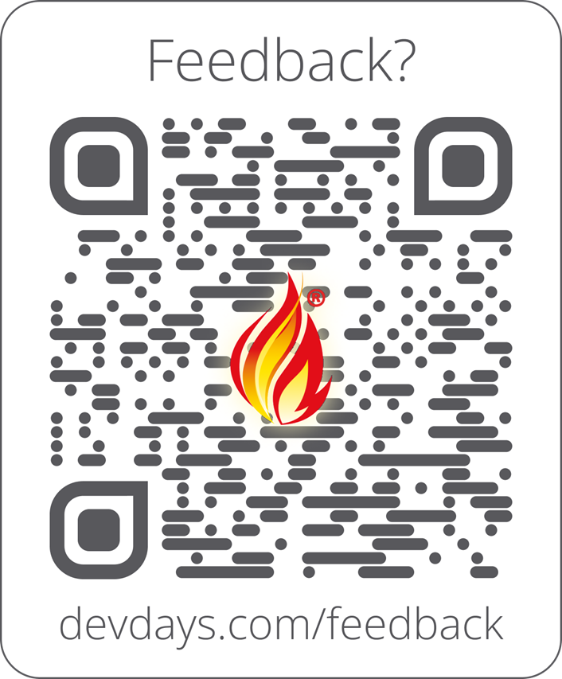
Feedback
Include link and/or QR code to collect feedback on your talk and DevDays
https://www.devdays.com/feedback/

